Slide 1
Proposal to expand Castleman Academy Trust
through academy conversion/transfer of five schools
Consultation meeting presentation
February 2020

Slide 2
What is the proposal ?
Ferndown First, Middle & Upper Schools, Corfe Hills School and Parley First School join Broadstone First & Middle Schools as part of Castleman Academy Trust
Joining schools convert to or transfer academy status.
To enable the schools to continue to provide an excellent education and achieve outstanding outcomes for all our pupils.
To control our own destiny………….in a fast changing educational landscape.
Why?
Notes:
Candice

Slide 3
Who is going to be in the proposed expanded Castleman Academy Trust?
Name | Age Range | Year Groups | Headteacher | Pupils
Broadstone First School | 5-9 | R, 1,2, 3, 4 | Mrs D Wilks | 300
Broadstone Middle School | 9-13 | 5, 6, 7, 8 | Mrs D Wilks | 514
Corfe Hills School | 13-18 | 9, 10, 11, 12, 13 | Mr P Keen | 877
Ferndown First School | 5-9 | R, 1,2, 3, 4 | Mrs J Di-Pede | 340
Ferndown Middle School | 9-13 | 5, 6, 7, 8 | Mrs G Allen | 566
Ferndown Upper School | 13-18 | 9, 10, 11, 12, 13 | Mr P Jones | 886
Parley First School | 5-9 | R, 1,2, 3, 4 | Mr J Bagwell | 312
 |  |  | Total | 3,795

Slide 4
What are the challenges all schools are facing?
Retaining, develop and recruiting the very best staff.
Greater scrutiny of school performance and pupil outcomes
Meeting the wider needs of pupils and their families
Maintaining financial sustainability within the current funding policy.
Government policy that schools become academies

Slide 5
How was the proposal developed?
May 24
Leadership Group
Mission, Values & Principles
June 18
Governing Bodies
Agreement to investigate and commence due diligence
July 2, Sept 10, Nov 26
Governor Working Group
Principles of governance, leadership & finance
July 12, Sept 11, Sept 25
Leadership Group
Development of Trust Improvement plans & application
Sept 24th
Governing Bodies
Approval of plans & agreement to submit applications
Oct 31st – Jan 15th
DfE
Consideration & approval of applications
March 2020
Governing Bodies
Stakeholder Consultation

Slide 6
What is the Castleman Academy Trust Mission?
We will provide the highest quality, inspirational education and care that ensures every child in our local community reaches their potential, regardless of their background.
Learning at Castleman Academy Trust will enable all young people to become
Successful learners who enjoy learning, make progress and achieve
Confident individuals who are able to live safe, healthy and fulfilling lives
Responsible citizens who make a positive contribution to society.
Our school values reflect the values in our community that promote personal development, equality of opportunity, economic well being, a healthy and just democracy and a sustainable future.
Independence
Inclusion
Respect
Creativity

Slide 7
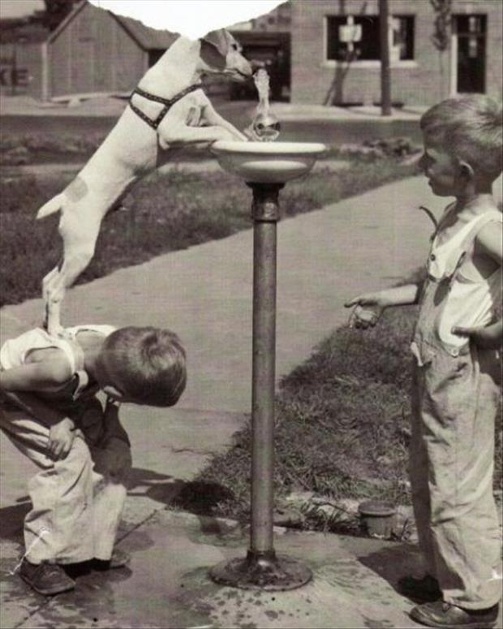
What are the Trust Principles?
Children first, always
We care deeply about our families
All are welcome here
We support and trust each other
We have high expectations and high performance
Great staff have lives outside school
Our adults are learners too
We have autonomy & freedom
We see possibility and are optimistic

Slide 8
How will our schools benefit?
Greater collaboration and joint working between Headteachers, senior leaders, staff and governors will offer a number of benefits.
Students & Pupils | Staff & Leadership | Leaders & Governors | School
Enhanced… Teaching and learning Curriculum SEND Provision Extra-curricular opportunities Access to resources Pastoral Care | Better… Professional development Academic planning Resource sharing Career opportunities Sharing practice | Greater… Leadership support & challenge Leadership training Governor training & support Operational management support Focus on Teaching & Learning | Effective and efficient… Central services Procurement and commissioning Resource sharing

Slide 9
What have we had to think about?
Joining schools have been working with the founding schools to develop the principles, structures and ways of working of the expanded Trust:
Vision, values and goals
Governance structure
Members & Trustees
Leadership structure
Delegation of authority to Governing Bodies
Trust central costs and school contributions or “Top slice”
Staff management and terms of employment
Future membership

Slide 10
How is the Trust governed & lead?
Headteacher remains responsible for running their school day-to-day.
Local Governing Body (LGB) continues to oversee their school.
Headteachers of each school and CEO form the Leadership Group.
CEO is accountable to DfE for Trust performance, leads intervention if necessary, chairs the leadership group and also oversees non-education functions of Trust e.g. finance and HR
Board of Trustees accountable for performance of all schools and pupil outcomes; vast majority chosen from existing governing bodies for their relevant skills / expertise and all schools are currently represented
Trust Members hold Trustees to account and are the guardians of the Trust vision & ethos
Notes:
Maureen

Slide 11
What will stay the same at our school?
Our community school ethos and values
Our own Headteacher
Our teachers and support staff
High standards of academic and personal development
Excellent quality of teaching and learning
School identity: name, logo and uniform
Our own Governing Body managing the school
Inclusive Admissions policy

Slide 12
What are the next steps?
Academy consultation runs until Friday, February 28th
Q&A from parent and staff meetings to be published by February 11th
Consultation survey opens February 6th and closes midnight February 27th
Governing Bodies and Boards to consider consultation report at meeting on March 10th and decide whether to proceed with expansion
Range of legal and regulatory tasks to be completed
Target date for transfer is September 1st 2020.

